Slide 1
Milestone 4: C++ 1
Ethan Flynn, Michael Cooney, Fadi Alrabadi, Ryan Conaway, Alex Williams​

Slide 2
Meeting Times
Monday: 6pm
Wednesday: 6pm
Saturday: 3pm
Meet through Microsoft Teams/Discord to work and discuss the project

Slide 3
Technology Stack and Tool Chain
Visual Studio/Visual Studio Code
Github
Cppcheck
Deleaker (Valgrind for windows)
Visual Studio Profiling Tool

Slide 4
Technology Devices
Ethan: Windows laptop, VS code​
Michael: Linux laptop, VS code​
Fadi: Windows/Linux PC and laptop, VS code​
Ryan: Windows/Linux PC and laptop, VS code​
Alex: Windows laptop, VS Code

Slide 5
Github Repository
Link: https://github.com/OnlyOnTuesday/PathfindingVisualisation.git

Slide 6
Project Description
Our project is a Maze generator/solver that uses different algorithms to solve a randomly generated "perfect" maze. It shows you a visualization of how the maze is generated and how each algorithm works to solve the maze.

Slide 7
Algorithms Included
Dijkstra’s
Depth-First Search
Rat in a maze
Wall Follower

Slide 8
Dijkstra’s Algorithm
Used to find the shortest path in the maze.
Visits every node or space in the maze and assigns each node a number, that number is the distance from the start node.
Each node that is further from the start node is assigned a number +1 from the node it came from.
When it has visited every node, it displays the shortest path (smallest number from start to end)

Slide 9
Depth-First Search
Algorithm for traversing or searching tree or graph data structures
Begins at the root node (start of the maze) and goes through the maze until it finds the goal aka the end of the maze.
If the algorithm hits a dead end, it will begin to backtrack until it is able to leave the dead end and find a new path and assigns the nodes that it has visited as “Walls” so it will not visit it again.

Slide 10
Rat in a Maze
Similar to the DFS algorithm
“Rat” prefers to move right and down
If the rat hits a dead-end, it will backtrack until it has found a path it has not visited yet.

Slide 11
Wall Follower
Also similar to the DFS and Rat in a Maze algorithms
Wall follower prefers to move left and down, while hugging the wall
Wall follower "hugs" the wall until it has found an exit or has returned to the start.

Slide 12
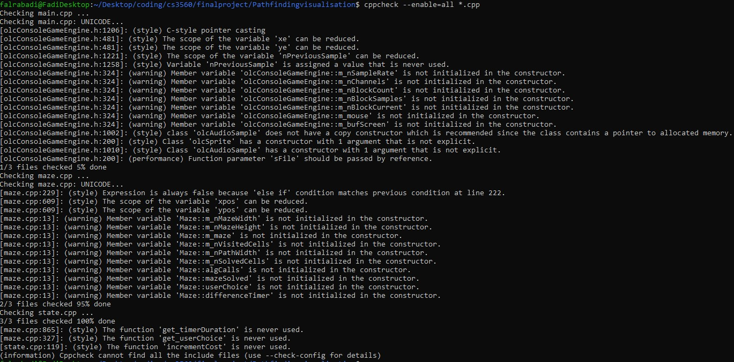
Static Analysis

Slide 13
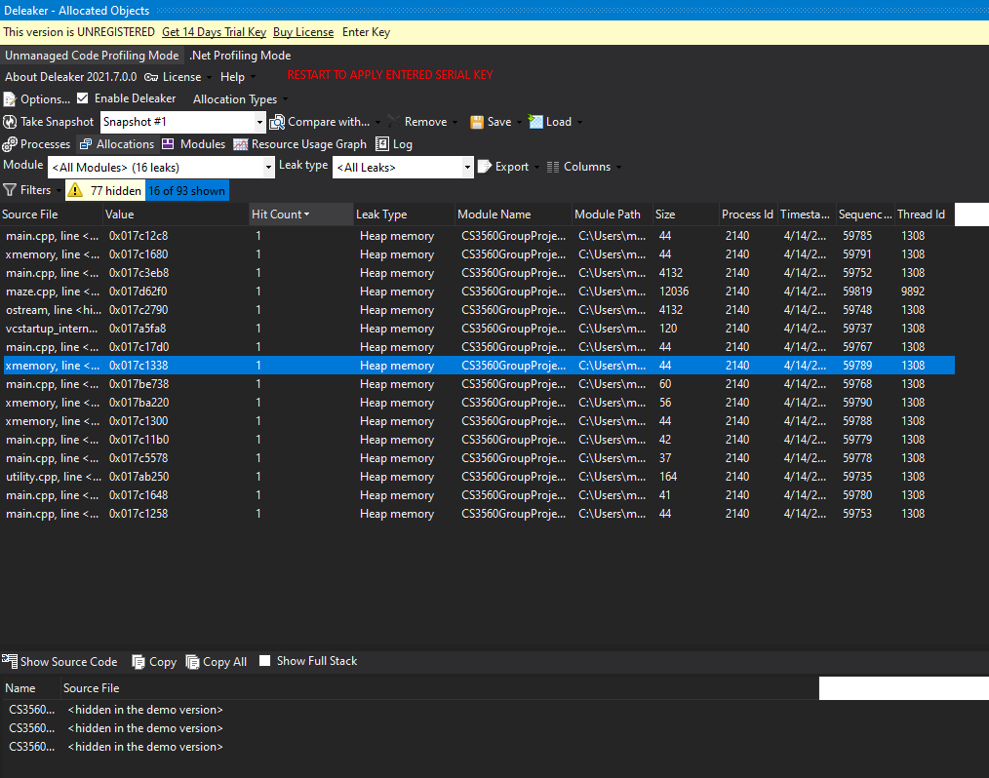
Deleaker
We used Deleaker for our dynamic analysis tool, specifically the Visual Studio Extension for Deleaker. Deleaker found several instances of memory leaks or improper heap allocation/deallocation; however, further information on the leaks is limited to the paid version

Slide 14
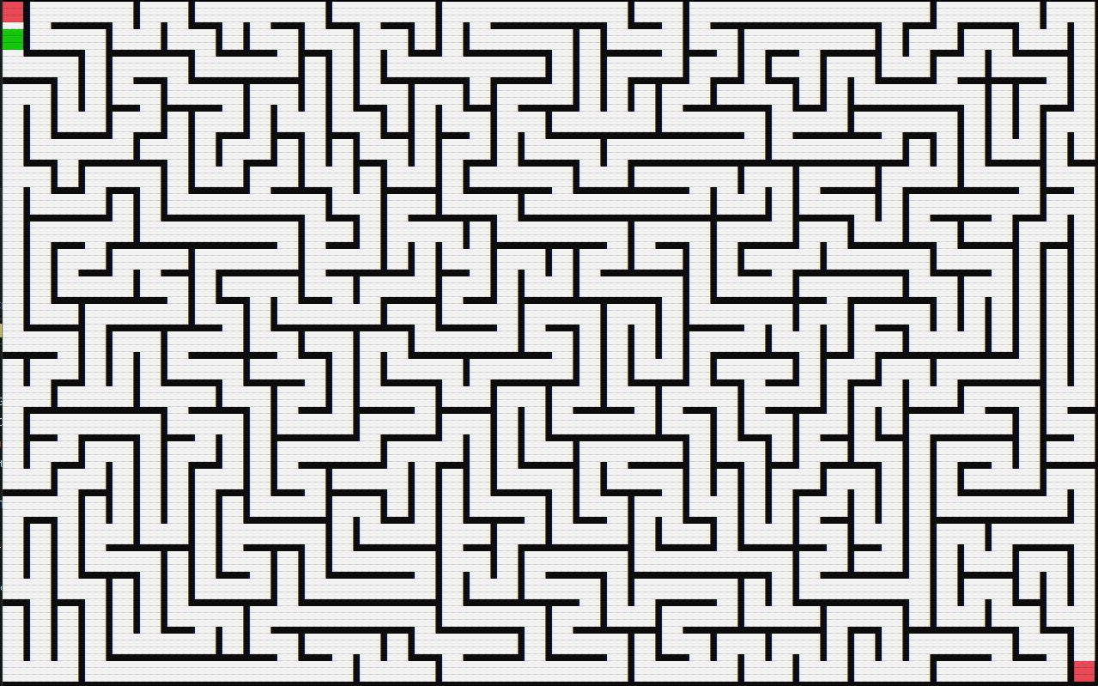
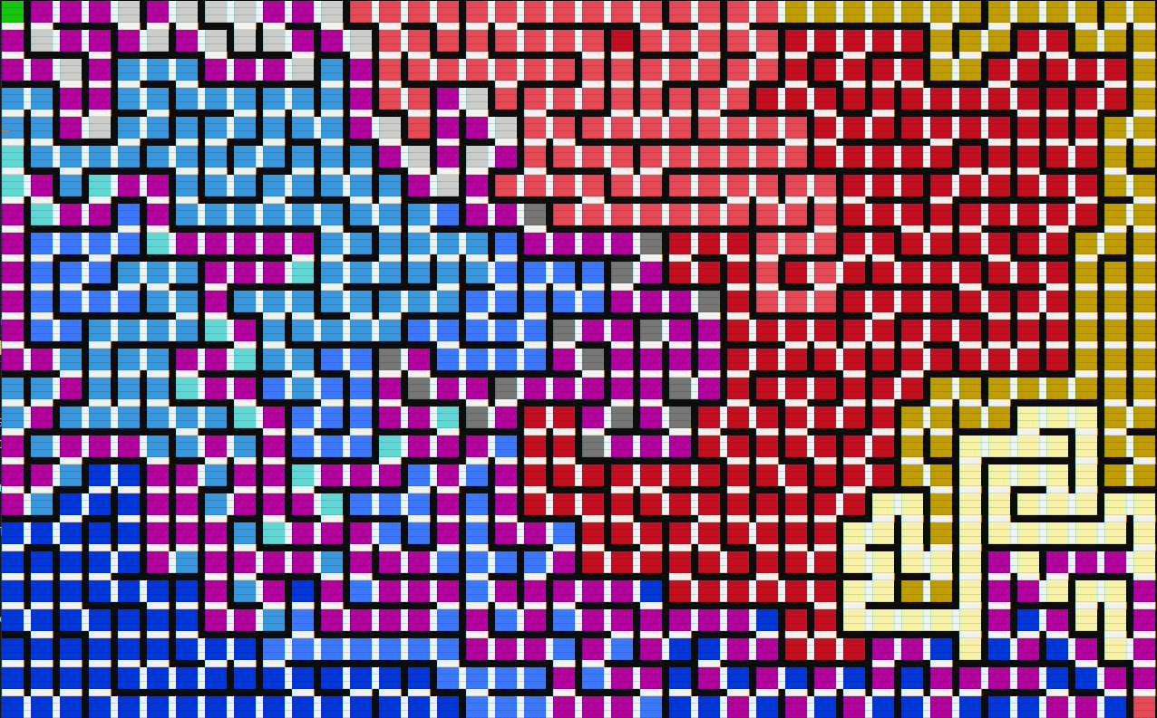
Unit Testing – Manual Gui Testing
Dijkstra():
Before
After

Slide 15
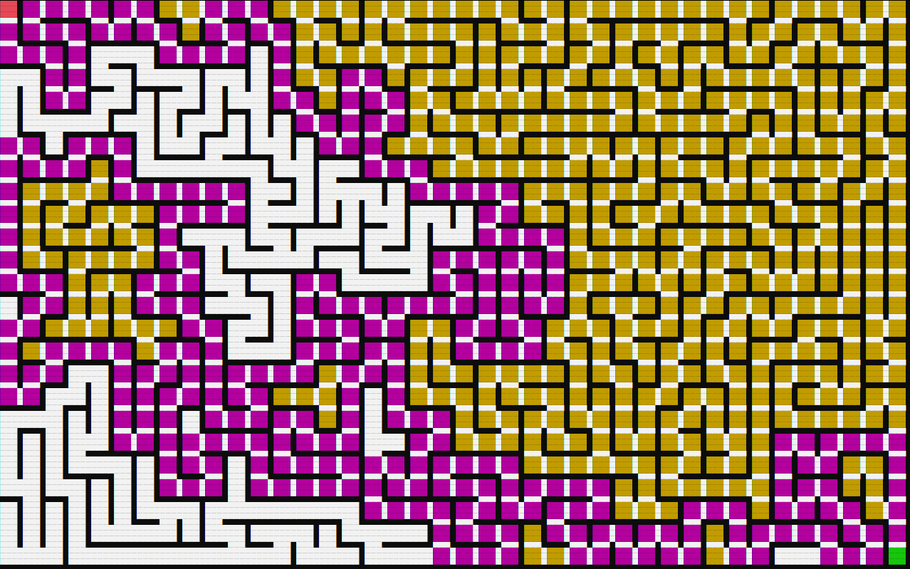
Unit Testing – Manual Gui Testing
Depth First Search():
Before
After

Slide 16
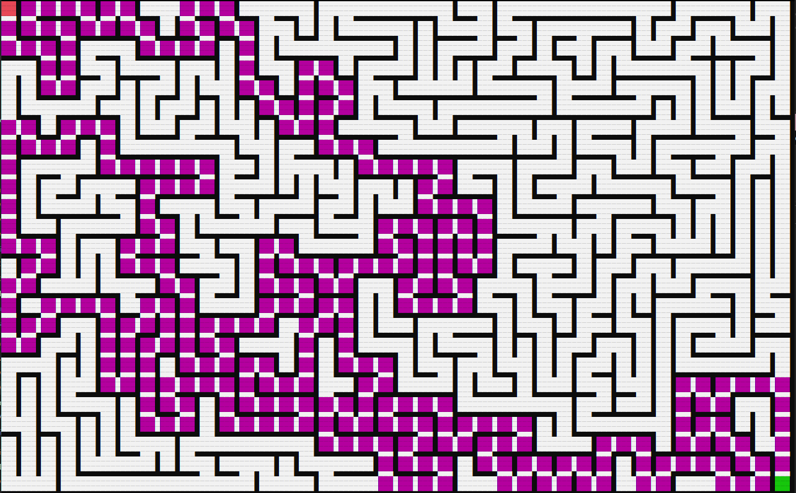
Unit Testing – Manual Gui Testing
Rat in a Maze():
Before
After

Slide 17
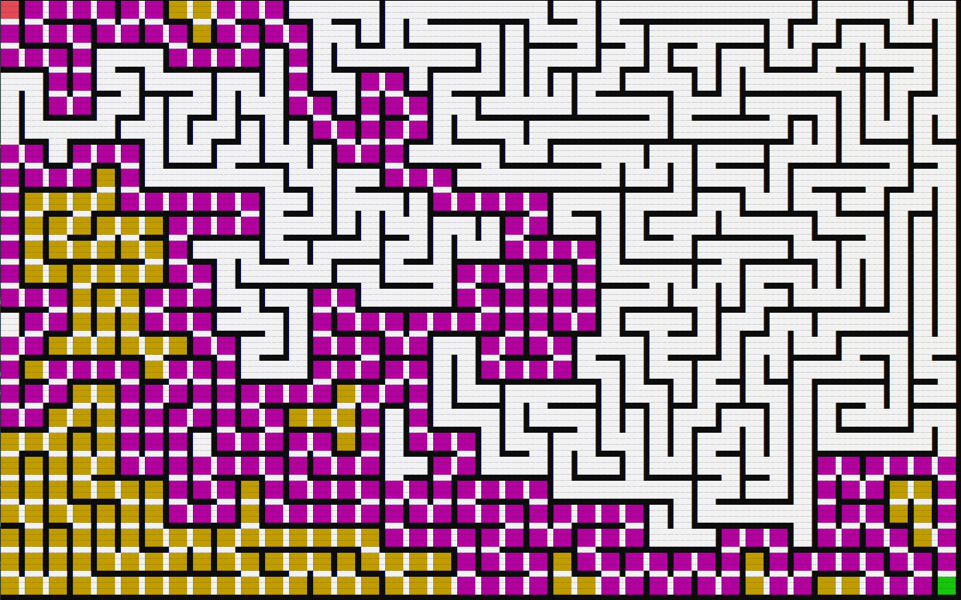
Unit Testing – Manual Gui Testing
Wall Follower():
Before
After

Slide 18
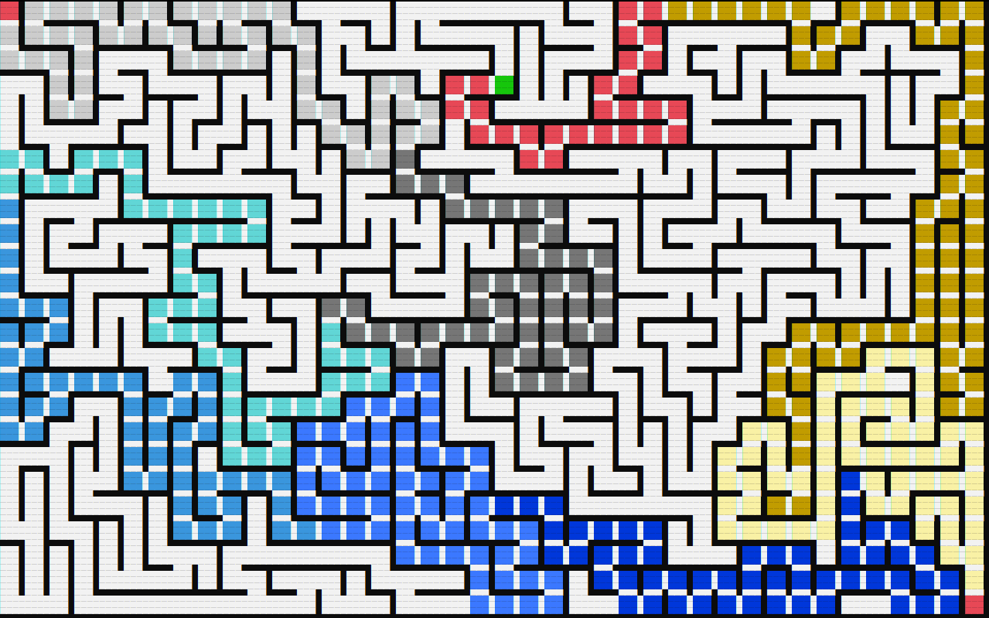
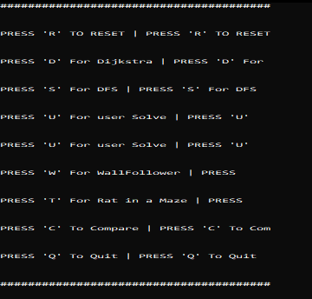
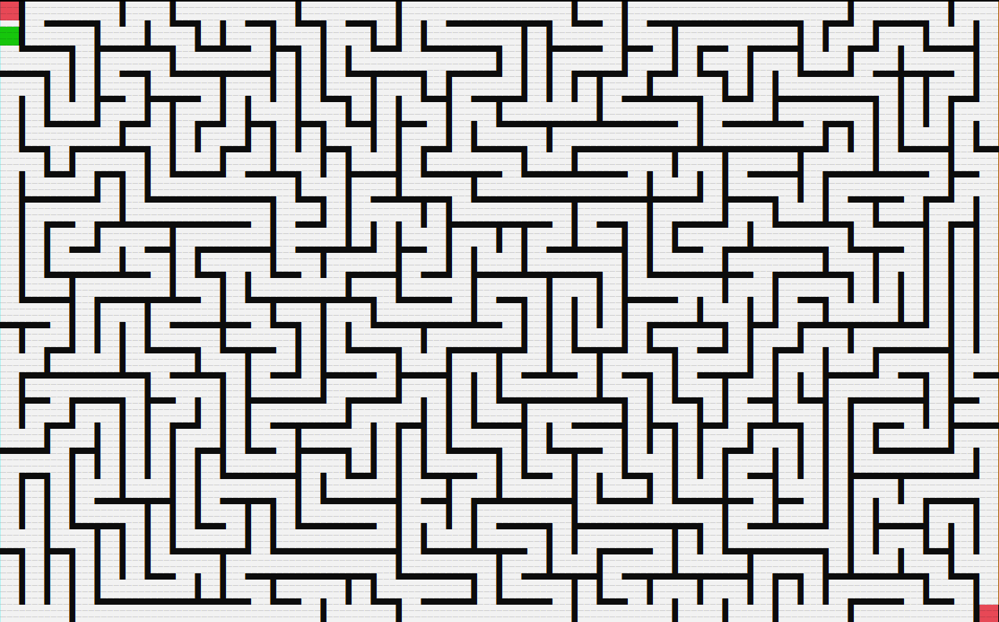
Unit Testing – Manual Gui Testing
Maze Menu and Reset ():
Before
Prompt()
After

Slide 19
Performance Profiling
We are monitoring the cpu performance of two principal functions:
generate() -- the function that handles creating the maze
dijkstra() -- the most complex maze solving algorithm
Generate()
Dijkstra()
Inspecting the cpu usage for generate() -- see Performance Generate.png -- we can see that the cpu bottlenecked by two sub-function calls, state::get_visit() and olcConsoleGameEngine::Draw(). The function, get_visit() is a state checking function while Draw() outputs the maze to the terminal. We can then see that the cpu is bottlenecked by state-checking the maze elements as well as drawing the corresponding maze.
Moving on to dijkstra() -- PerformanceDijkstra.png. Most of the cpu usage is due to the stack manipulation, popping and adding to the stack. This is a critical backtracking element that dijkstra algorithm relies heavily on, so it is not surprising the cpu is bottlenecked by it.

Slide 20
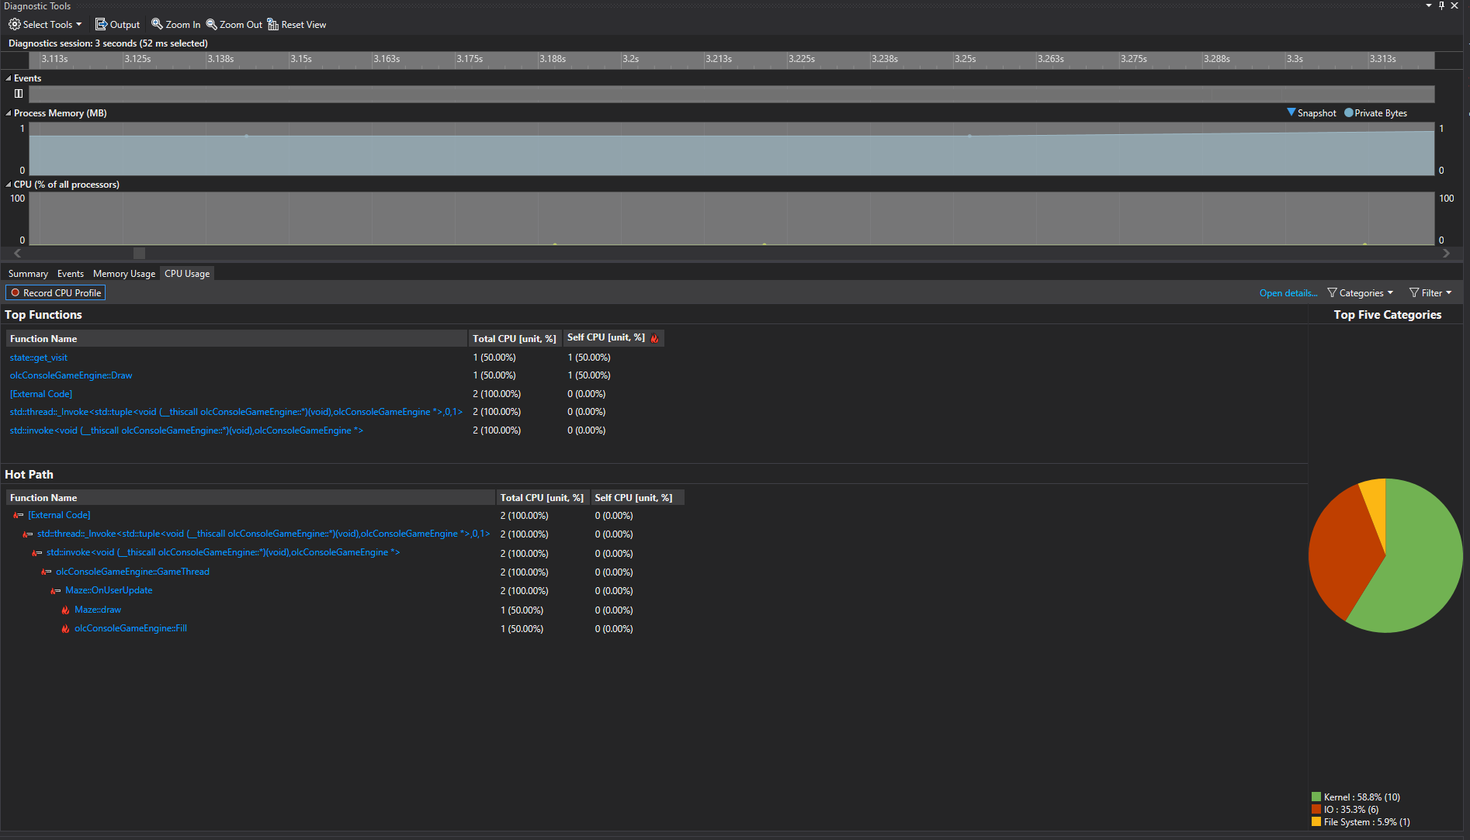
Profiling Tool – generate()

Slide 21
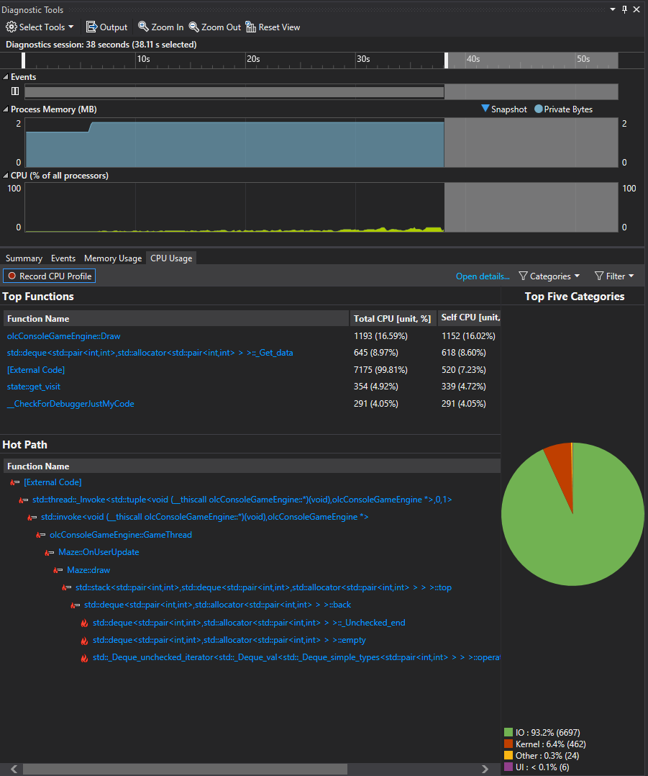
Profiling Tool – dijkstra()

Slide 22
Tool Reflections
The Good:
Visual Studio and VScode: excellent text editors with rich features
Cppcheck: very helpful to run code that would not compile and solve those issues
Github: provided a great way to work and share progress between team members
The Bad:
Valgrind/Deleaker : Valgrind does not work on Windows and Deleaker's use was limited

Slide 23
Contributions:
Ethan Flynn – Implementing Rat in a Maze into GUI
Michael Cooney -- Finish Dijkstra and implement into GUI
Fadi Alrabadi -- Implementing Depth First Search into GUI
Ryan Conaway – make maze menu prompt/reset() function
Alex Williams -- make menu function and implementation

Slide 24
Demo

